Slide 1
Game Development Javascript
Abhishek Deora

Slide 2
What is P5JS

Slide 3
Introduction
p5.js is a JavaScript library that starts with the original goal of Processing, to make coding accessible for artists, designers, educators, and beginners, and reinterprets this for today's web.
<script src="../p5.min.js"></script>

Slide 4
My first project
Instead of learning the syntax here, let us make your very first game in javascript using p5js.
In the end of the talk, I will be showing you some of the games which i built in 15-20 minutes.
This game will be very simple. You must have played the game in which the objective is to make the egg land in the bucket.
So let us see whether P5JS is really that simple and powerful

Slide 5
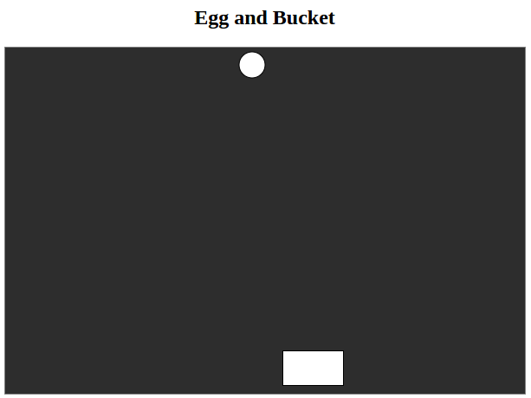
Easy right
Now i hope you understand how powerful this js library is and how easily you can make all those mini games which you used to play as kids eg: snake game, bounce, flappy bird, sky war and many more.

Slide 6

Examples
Now let me show you a few examples.
Flappy Bird
Sky wars
Nqueen
Asmita triathlon

Slide 7
Thank You
https://www.github.com/adeora7

